Slide 1
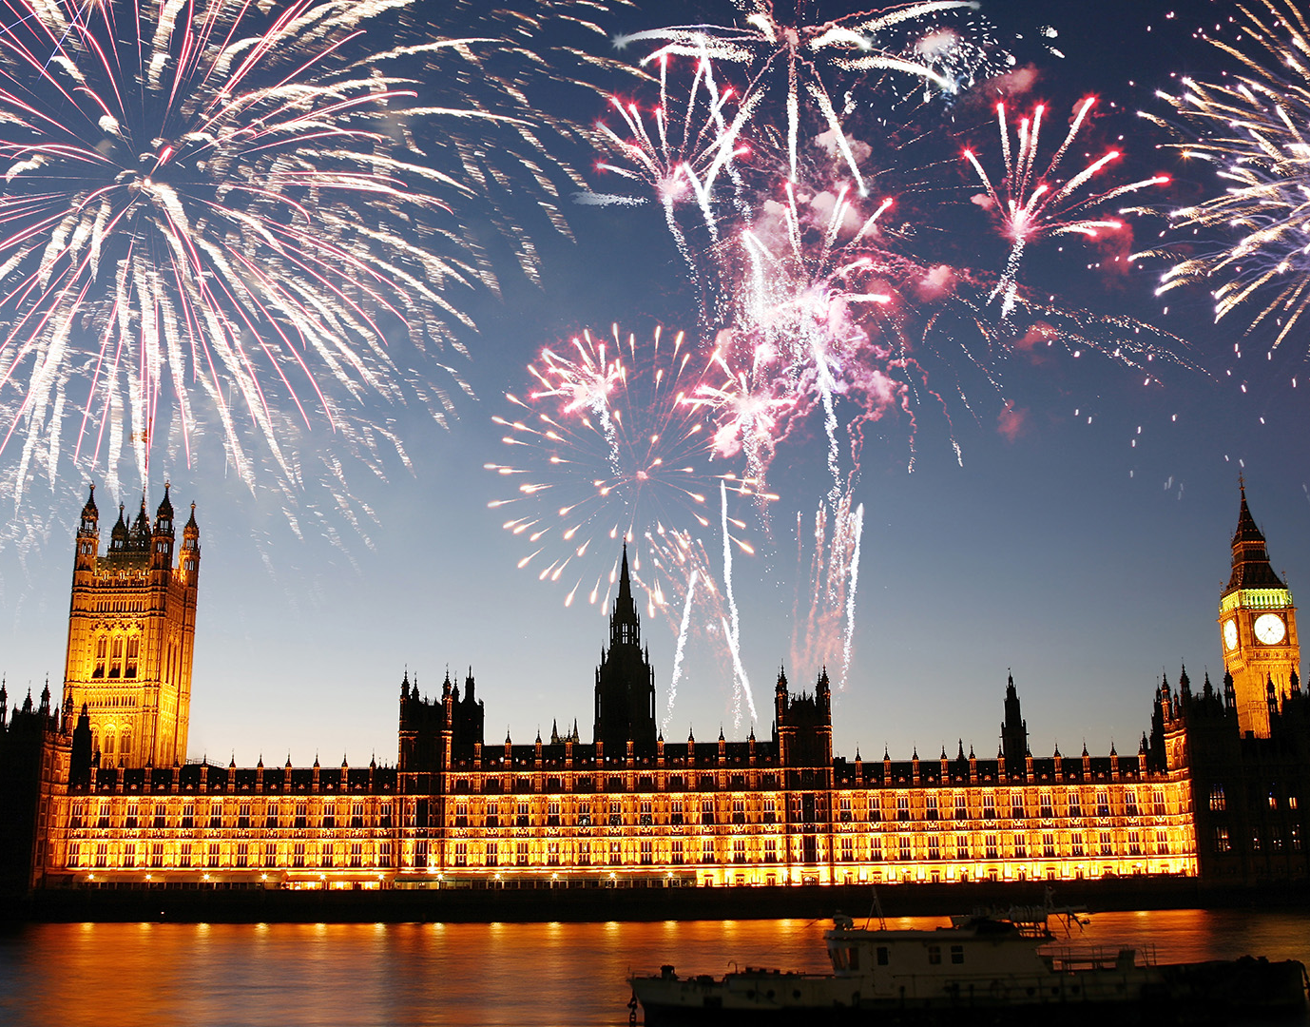
Bonfire Night
Tyrion, Zhao
Nov. 2018

Slide 2
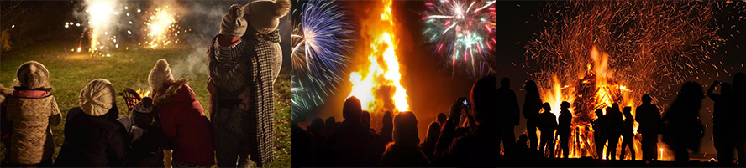
Bonfire and firework on the evening of Nov. 5
British people celebrate this night with bonfire parties, including huge bonfires in public parks, and firework displays.

Slide 3
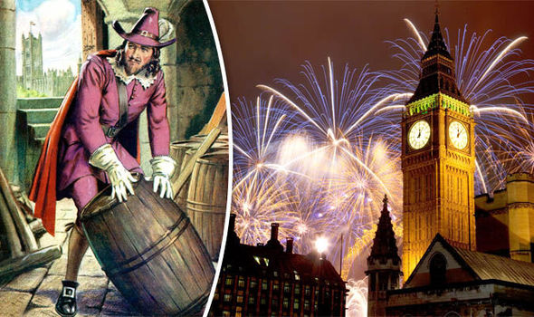

Origin
Bonfire night, also called Guy Fawkes Night
Guy Fawkes tried to blow up London’s Houses of Parliament in 1605 because he wanted to kill King James I for King’s crude policy to Catholics.
So Robert Catesby made his plan with a group of 12 English Catholic gentlemen, and Fawkes was in charge of the gunpowder.
What happened next? And why it finally became a celebration? Let’s see the video.

Slide 4
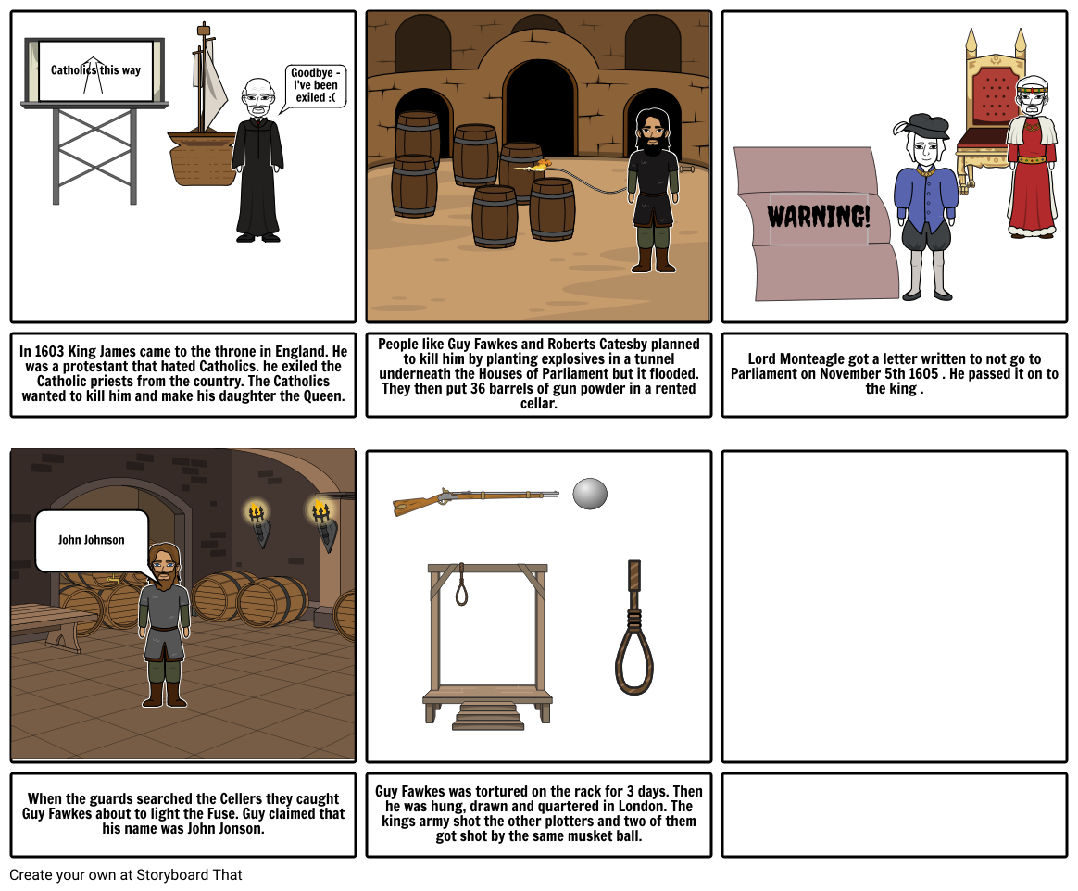
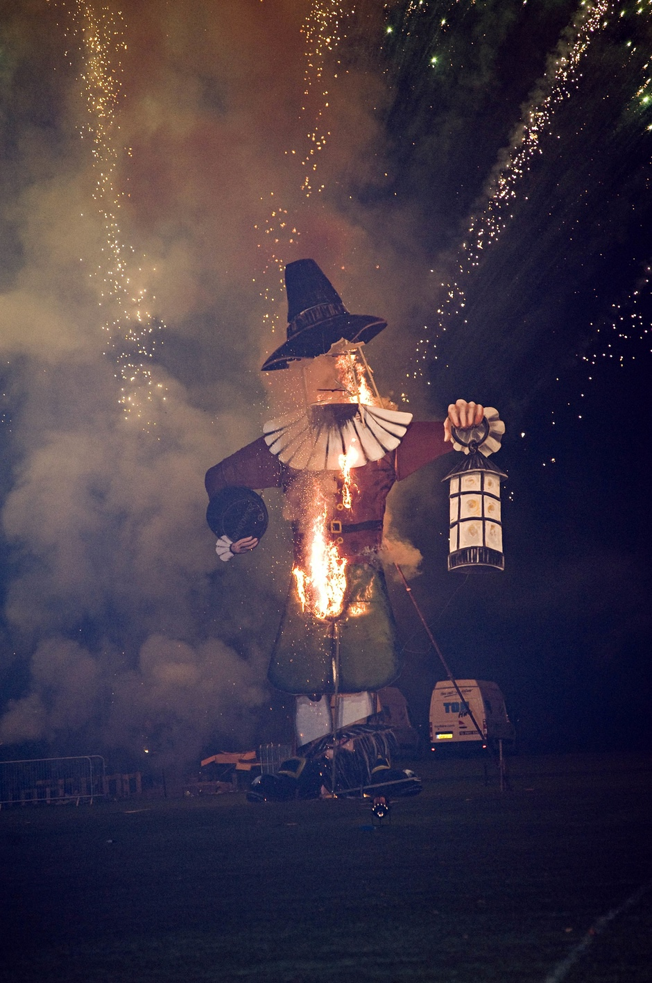

Slide 5
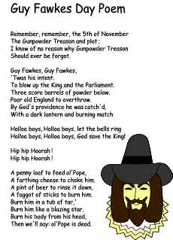
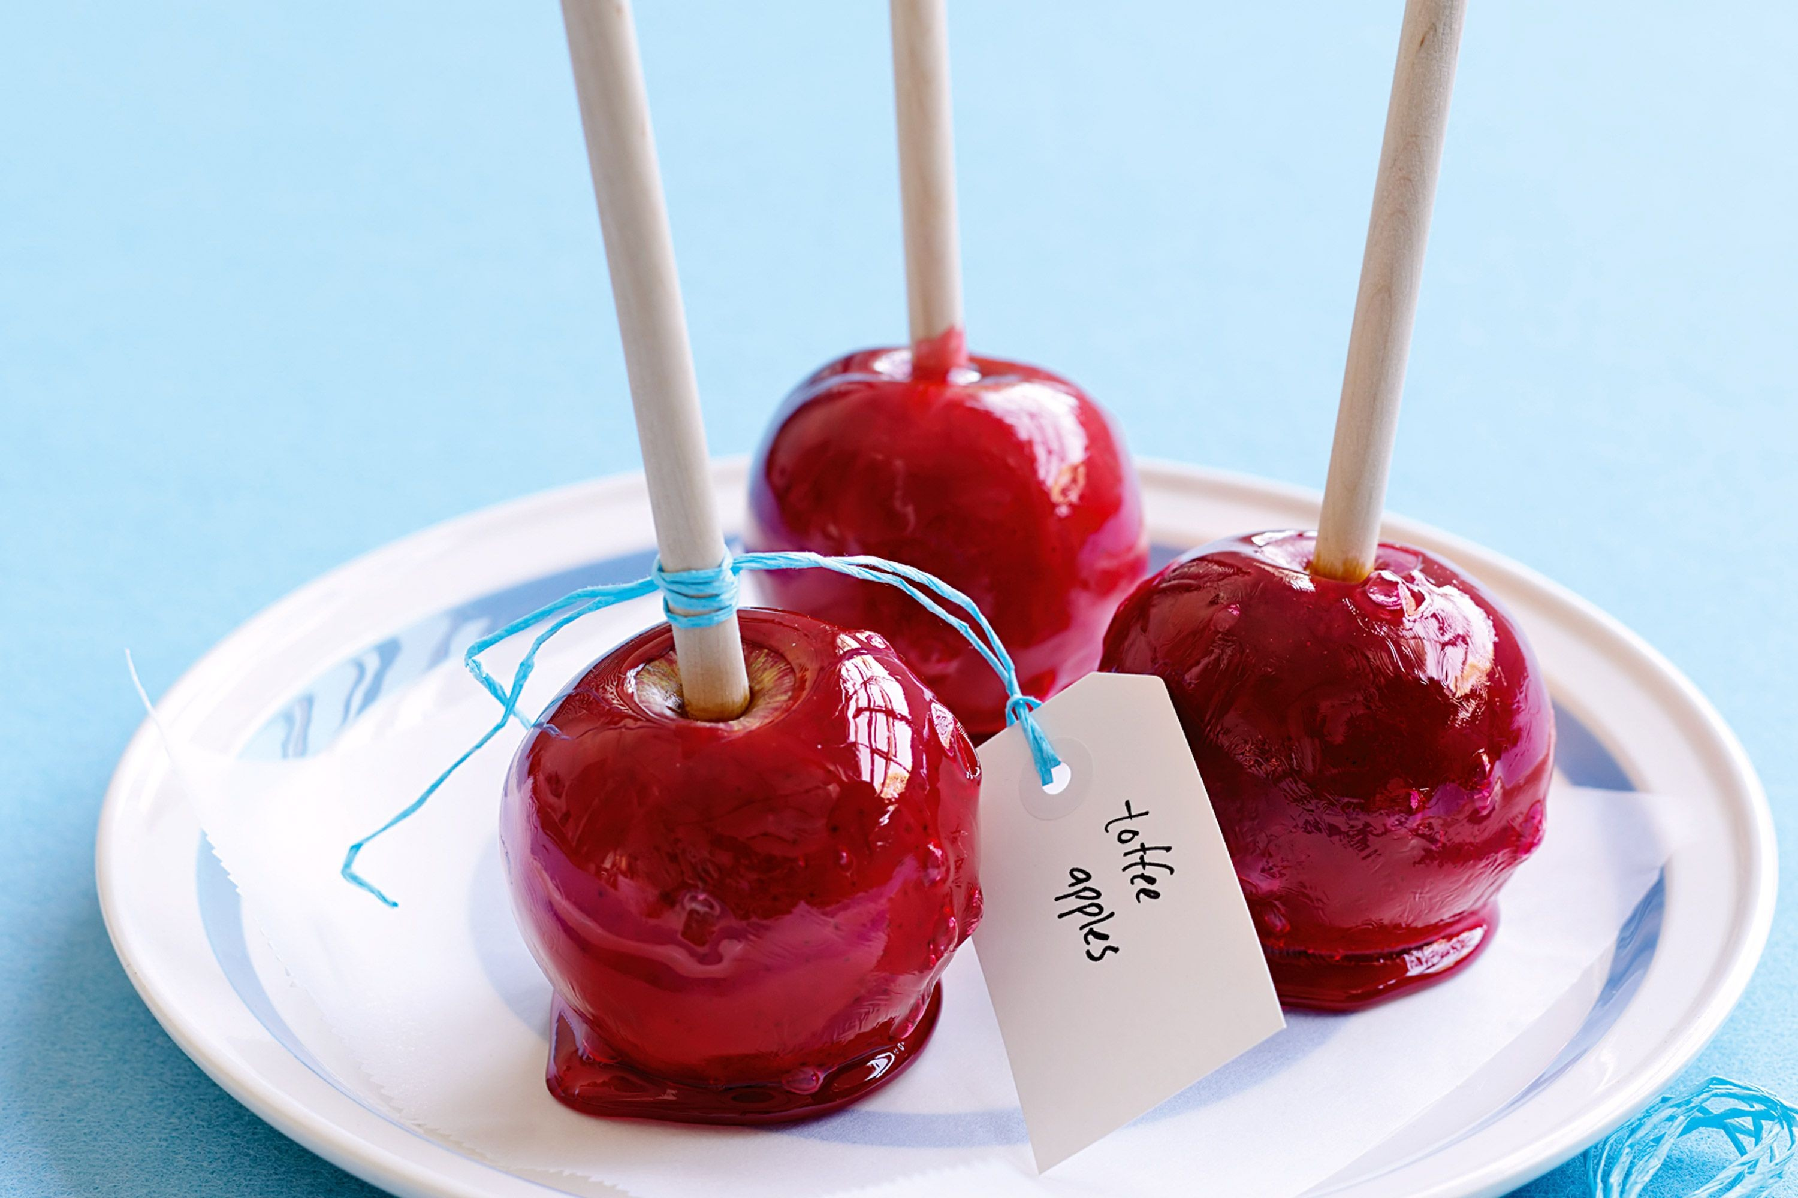
Bonfire Night today
SECTION 1
SECTION 2
The celebrations have remained mostly the same for hundreds of years, although people nowadays don’t go to church as part of the day .
Most towns and villages organize public displays where you can stand by huge bonfires and watch the fireworks as you eat a toffee apple or a hot snack.
Many children learn this poem about Bonfire Night at school, and they look forward to a special evening out.

Slide 6
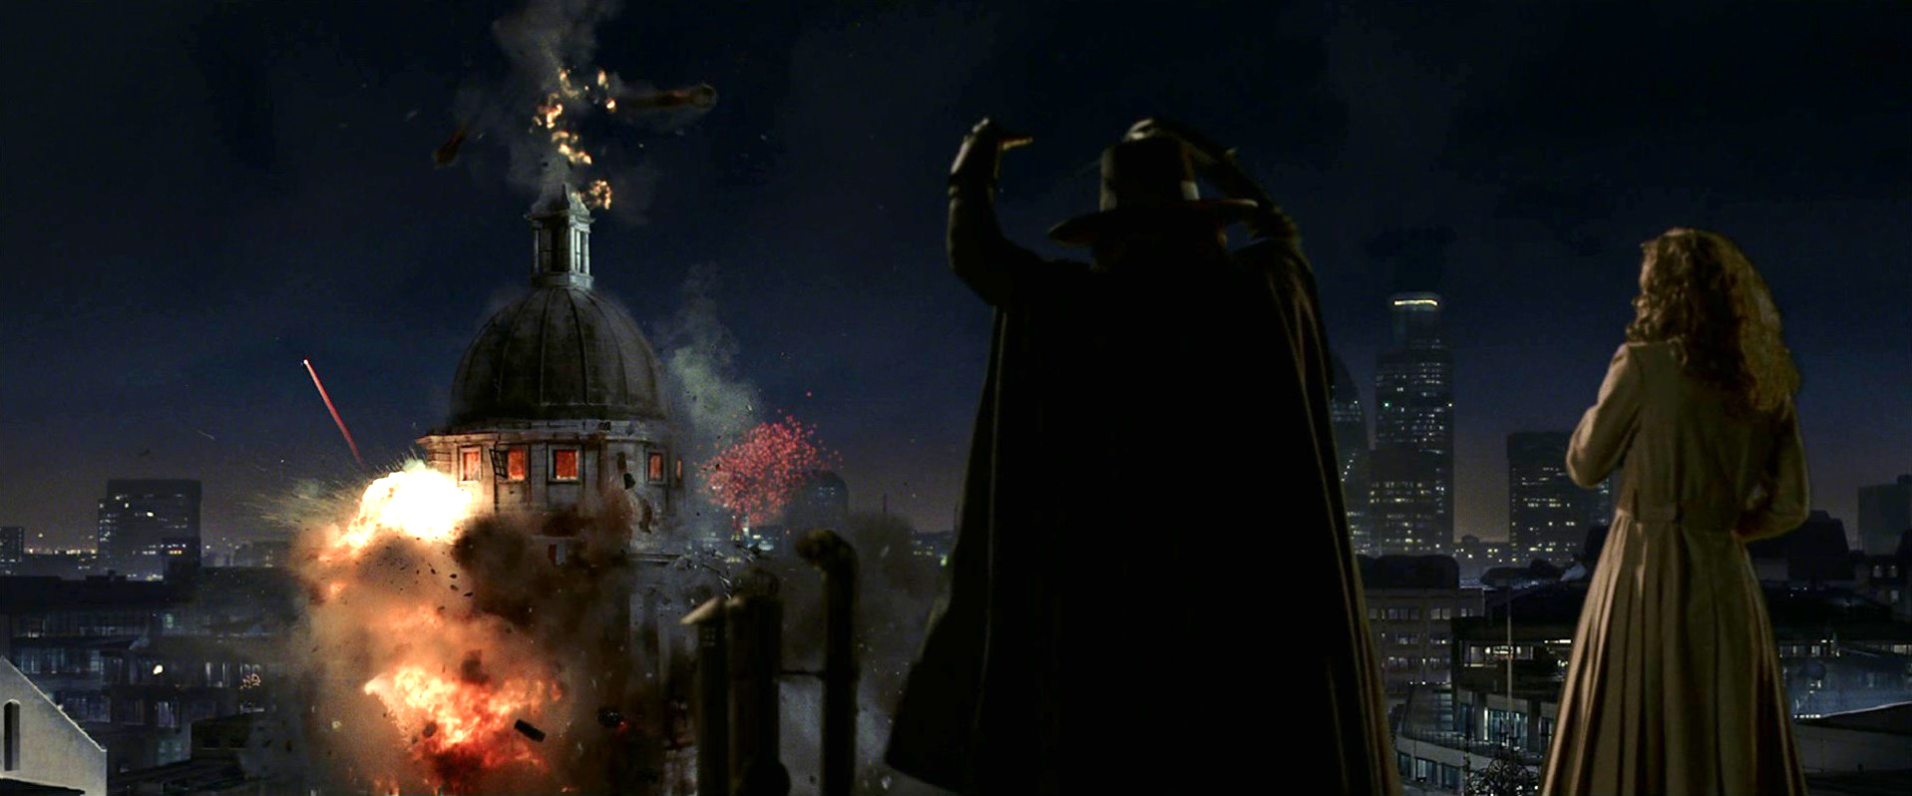
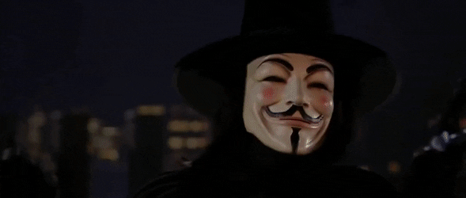
v for vendetta

Slide 7
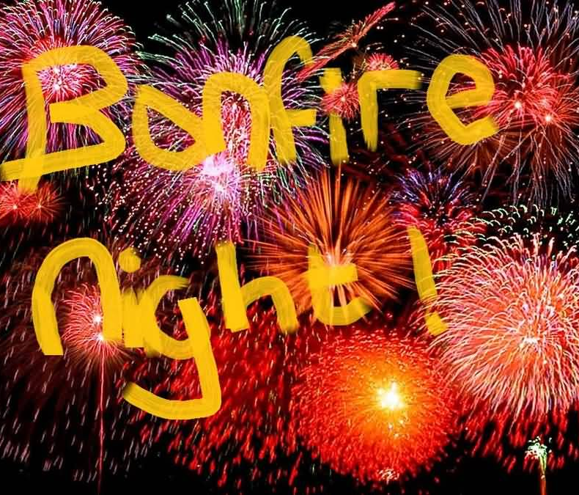
THANK YOU!
Tyrion, Zhao
From:
RTH

